Slide 1



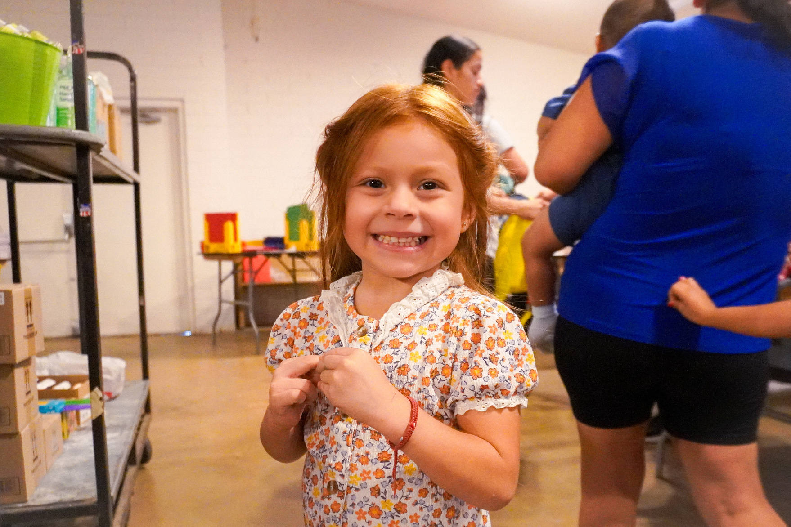
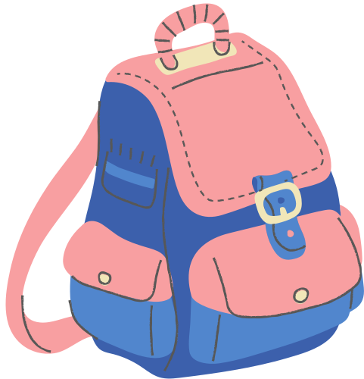


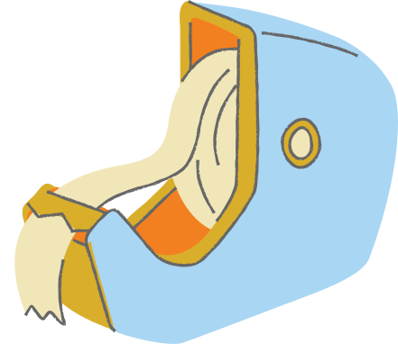
THE PAULA COMPTON
SCHOOL
SUPPLY
DRIVE
riovistacenter.com/school

Slide 2
THE PAULA COMPTON
SCHOOL SUPPLY DRIVE

Slide 3


ITEMS NEEDED
  BACKPACKS
  POCKET FOLDERS
  #2 PENCILS
  WATERCOLOR PAINT
  SPIRAL NOTEBOOKS
  NOTEBOOK PAPER
  COLORED PENCILS
  WASHABLE MARKERS
  SCISSORS
  PENS
  CRAYONS
  ERASERS
  DRY-ERASE MARKERS
  WIDE-RULED NOTEBOOK
  BINDERS (1, 2, 3 AND 4 INCH)
  GLUE STICKS
  HIGHLIGHTERS
  RULERS
  DISINFECTANT WIPES
  HAND SANITIZER
  KLEENEX
Cash donations are also needed to allow us to purchase these items in bulk. $20 will cover the cost of these items per child.

Slide 4

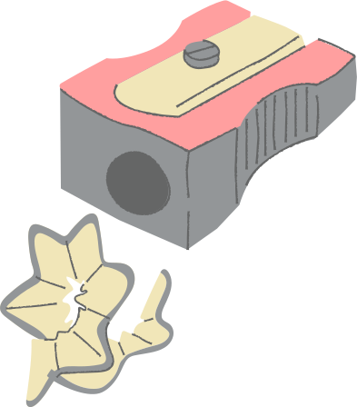
DONATION DROP OFF
July 6th - 27th
Casa de Amor
819 S. MacDonald
Mesa, AZ 85210
Cash donations can be mailed in & designated to "Back-to-School" in the memo.

Slide 5
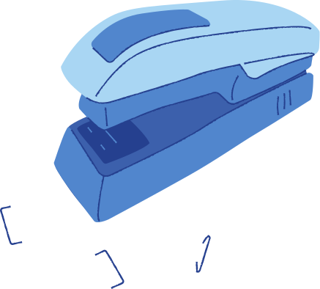


VOLUNTEER
Do you want to help sort and pack school supplies for children at Casa de Amor?
CONTACT US
Reach out to Ana about donation or volunteer questions at
(480) 464-2877
Analanderos31@gmail.com

Slide 6
DONATION DROP OFF
ITEMS NEEDED
July 6th - 27th
  BACKPACKS
  POCKET FOLDERS
  #2 PENCILS
  WATERCOLOR PAINT
  SPIRAL NOTEBOOKS
  NOTEBOOK PAPER
  COLORED PENCILS
  WASHABLE MARKERS
  SCISSORS
  PENS
  CRAYONS
  ERASERS
  DRY-ERASE MARKERS
  WIDE-RULED NOTEBOOK
  BINDERS (1, 2, 3 AND 4 INCH)
  GLUE STICKS
  HIGHLIGHTERS
  RULERS
  HAND SANITIZER
  KLEENEX
  DISINFECTANT WIPES
Casa de Amor
819 S. MacDonald
Mesa, AZ 85210
Cash donations can be mailed in & designated to "Back-to-School" in the memo.
VOLUNTEER
Do you want to help sort and pack school supplies for children at Casa de Amor?
CONTACT US
Reach out to Ana about donation or volunteer questions at
(480) 464-2877
Analanderos31@gmail.com
Cash donations are also needed to allow us to purchase these items in bulk. $20 will cover the cost of these items per child.

